Slide 1
PIT Overload Analysis in Content Centric Networks
Authors: Matteo Virgillo, Guido Marchetto, and Riccardo Sisto
Publisher: ICN, 2013
Presenter: Chia-Yi, Chu
Date: 2013/10/09

Slide 2
Outline
Introduction
Content Centric Networking
Problem Description
Related Work
PIT Resilience Analysis

Slide 3
Introduction
Providing a performance evaluation of some possible PIT architectures in terms of resilience to overload conditions.
Experiments are conducted by means of an ad-hoc simulator, designed to recreate the behavior of a CCN network and to track memory usage at CCN nodes.

Slide 4
Content Centric Networking (1/3)
Interest packets
  request a (piece of) resource
  include the content name
    in the form of a Uniform Re-source Identifier (URI)
  plus a set of parameters useful for Interest processing.
Data packets
  responses to client requests
  be used to deliver pieces of data

Slide 5
Content Centric Networking (2/3)
CCN nodes are equipped with three data structures:
  Content Store (CS)
    where Data packets are cached. Each Interest arrival causes a Content Store lookup
  Pending Interest Table (PIT)
    which is the data structure where routers annotate forwarded Interests and the respective arrival interfaces.
  Forwarding Information Base (FIB)
    which is the equivalent of the IP routing table.

Slide 6
Content Centric Networking (3/3)
When a client generates an Interest, each router in the path towards the destination adds an entry in its PIT.
The entry remains in the PIT for a time interval called LifeTime.
If the LifeTime expires and the response has not yet arrived, the memory is released.

Slide 7
Problem Description (1/3)
PIT is used to maintain the state of each active flow.
It grows with users sending their Interests and shrinks when Data packets arrive at the router.
The PIT size might represent a bottleneck for the entire CCN infrastructure.
Might be exacerbated by a massive usage of long Interest LifeTimes
  increase the number of simultaneous entries in the PIT

Slide 8
Problem Description (2/3)
30s is considered a safe value
  longer timers may be undesirable for intermediate proxies placed between the server and the client.
  FaceBook and some web-based mail applications, which to our experience often use timers of more than one minute.
We have to consider that one or more malicious users could craft artificial requests with the purpose of filling the available PIT memory on routers
  implementing a Distributed Denial of Service (DDoS) attack.

Slide 9
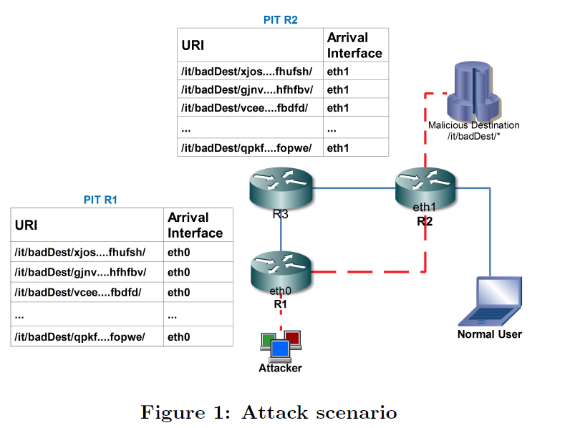
Problem Description (3/3)
Notes:
distributedly generating Interest packets that contain a valid destination prefix
but non-existing resource names, so that routers properly
forward Interests and store new entries in their PITs, but
responses never come back.

Slide 10
Related Work (1/3)
Design issues
  “On content-centric router design and implications.”
    presents an efficient router design and describes some possible usage scenarios.
  “Scalable ndn forwarding: Concepts, issues and principles.”
    identifies key issues related to the protocol fast speed implementation and establishes some principles to be observed in order to design scalable forwarding architectures.
  “A reality check for content centric networking.”
    presents a feasibility study of CCN and concludes that CCN nodes based on current technologies would still be unable to sustain requests arrival rates at the Internet scale.

Slide 11
Related Work (2/3)
Data Structure
  “On pending interest table in named data networking.”
    proposes a tree-like PIT structure
  “Dipit: a distributed bloom-filter based pit table for ccn nodes.”
    present a PIT architecture based on Bloom Filters.

Slide 12
Related Work (3/3)
Privacy problem
  “On preserving privacy in content-oriented networks.”
  “Networking named content.“
  “Voccn: Voice-over content-centric networks.”
Solutions to attacks
  “Mitigate ddos attacks in ndn by interest traceback.”
  “Dos & ddos in named-data networking.”

Slide 13
PIT Resilience Analysis
Considering three possible architectures
  Simple PIT: storing all the bytes that compose an URI.
  Hashed PIT: storing fixed length entries evaluated as hash values of the URIs.
  DiPIT: multiple Bloom Filters placed in each router interface.

Slide 14
PIT Resilience Analysis – Simulation scenario (1/4)
Develop a full custom event-driven Java simulator
  Plan to use NS-3 based NdnSIM CCN simulator in the future
To recreate realistic scenarios
  real structure of the Telecom Italia network
  subscriptions currently active in the Telecom Italia network around 9 million
  access bandwidths are considered uniform for simplicity and equal to 7Mbps (download) and 1 Mbps (upload)
  overall header size of the protocols underlying CCN is assumed fixed to 20 bytes.

Slide 15
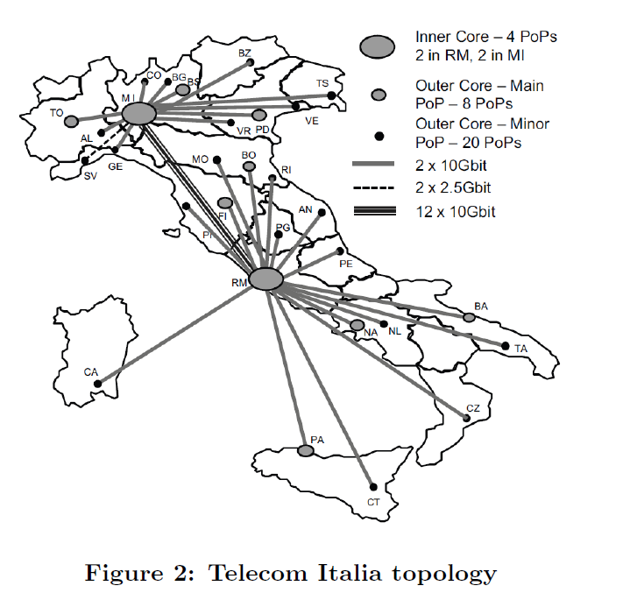
PIT Resilience Analysis – Simulation scenario (2/4)

Slide 16
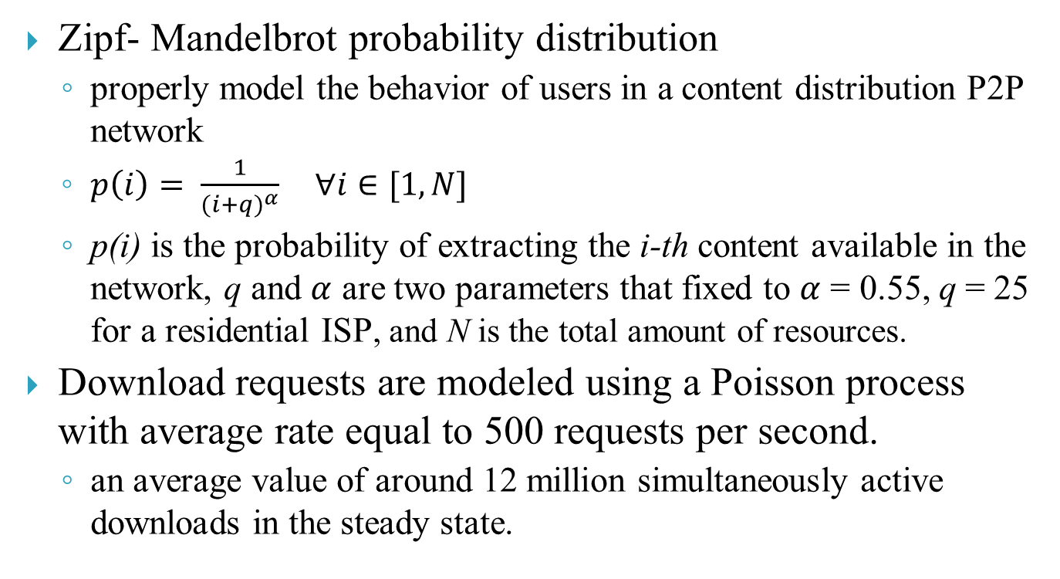
PIT Resilience Analysis – Simulation scenario (3/4)
Zipf- Mandelbrot probability distribution
  properly model the behavior of users in a content distribution P2P network
  $p\left(i\right)= \frac{1}{{(i+q)}^{α}} ∀i∈[1,N]$
  p(i) is the probability of extracting the i-th content available in the network, q and $α$ are two parameters that fixed to $α$ = 0.55, q = 25 for a residential ISP, and N is the total amount of resources.
Download requests are modeled using a Poisson process with average rate equal to 500 requests per second.
  an average value of around 12 million simultaneously active downloads in the steady state.

Slide 17
PIT Resilience Analysis – Simulation scenario (4/4)
fix the PIT size to 1 GB
  In the DiPIT case, this value refers to the overall available filters memory
Attack parameters
  Maximum aggregate attack bandwidth of 4 Gb/s
  Interest LifeTimes values that vary between 4s and 180s
Notes:
4s = the default value considered in the CCNx

Slide 18
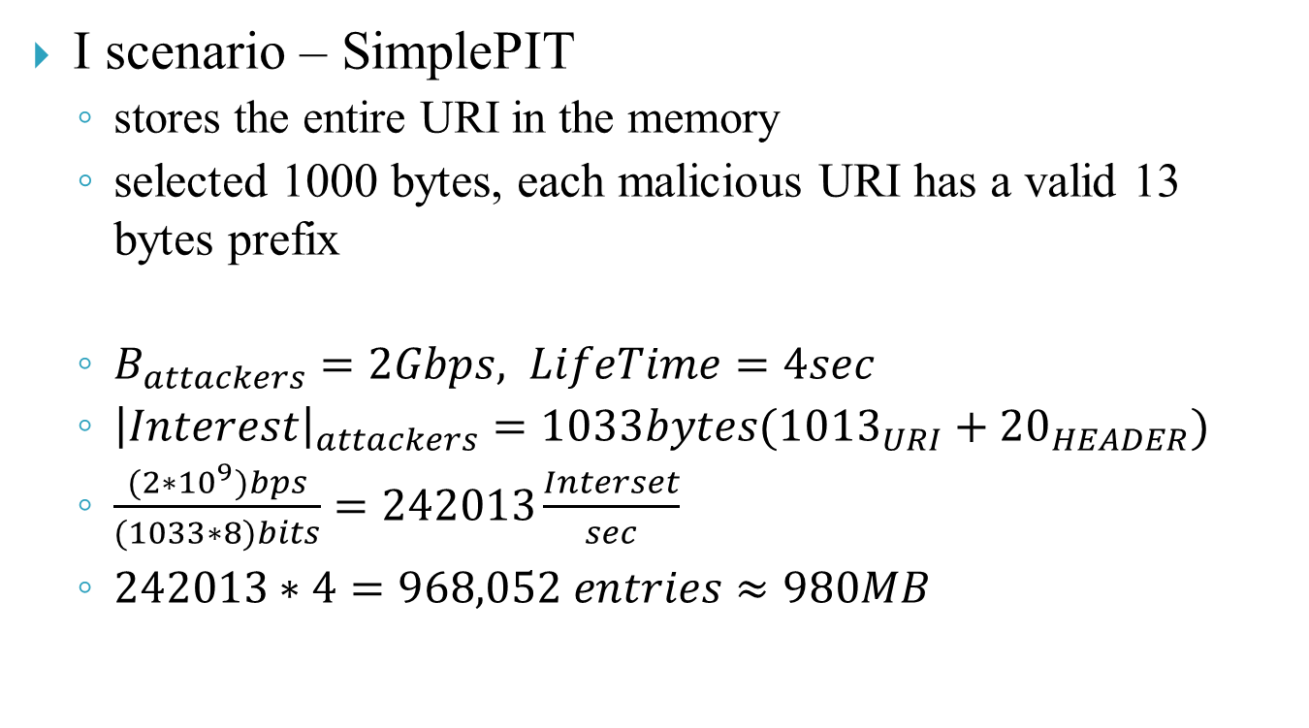
PIT Resilience Analysis – Result (1/4)
I scenario – SimplePIT
  stores the entire URI in the memory
  selected 1000 bytes, each malicious URI has a valid 13 bytes prefix
  $B_{attackers}=2Gbps, LifeTime=4sec$
  ${\left|Interest\right|}_{attackers}=1033bytes({1013}_{URI}+{20}_{HEADER})$
  $\frac{(2∗{10}^{9})bps}{(1033∗8)bits}=242013\frac{Interset}{sec}$
  $242013∗4=968,052 entries≈980MB$

Slide 19
PIT Resilience Analysis – Result (2/4)
II scenario – HashedPIT
  storing a fixed length entry for each URI in transit
  Using SHA-1 hashing algorithm
  size for an attacker's URI is 20 bytes, according to the SHA-1 output digest (160 bits)
  Longer URIs are useless as would be reduced to 20 byte strings by CCN nodes.

Slide 20
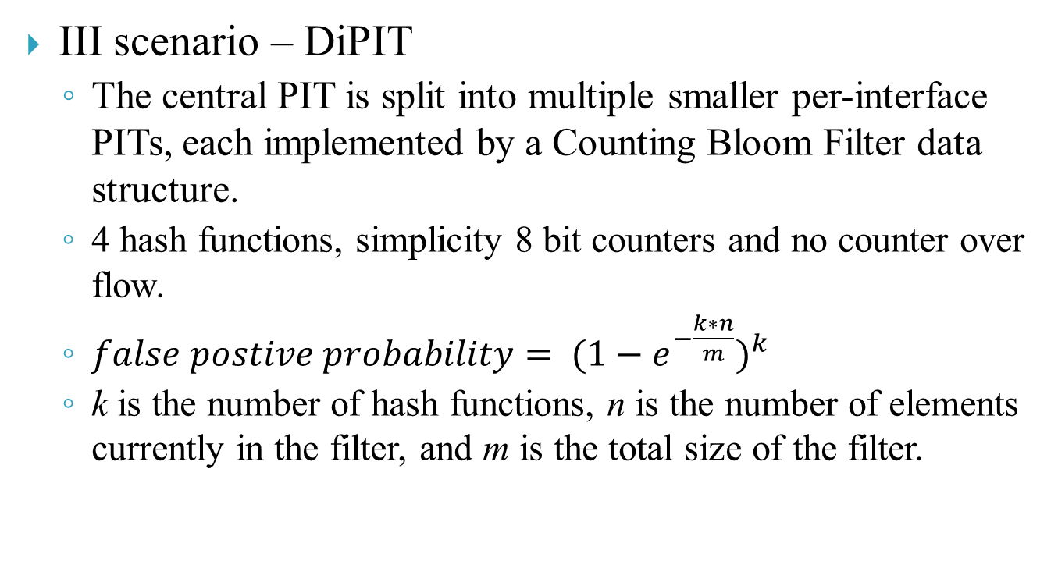
PIT Resilience Analysis – Result (3/4)
III scenario – DiPIT
  The central PIT is split into multiple smaller per-interface PITs, each implemented by a Counting Bloom Filter data structure.
  4 hash functions, simplicity 8 bit counters and no counter over flow.
  ${false postive probability= (1−e^{−\frac{k∗n}{m}})}^{k}$
  k is the number of hash functions, n is the number of elements currently in the filter, and m is the total size of the filter.

Slide 21
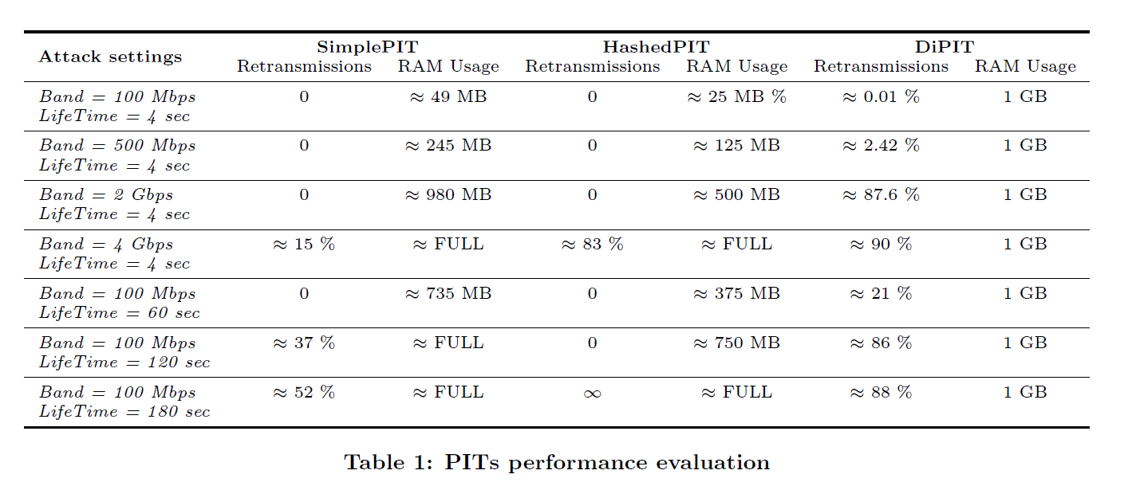
PIT Resilience Analysis – Result (4/4)

Slide 22
PIT Resilience Analysis – Discussion (1/4)
None of the analyzed PIT architectures is overloaded during normal operation in the considered network scenario. Even with a low intensity attack, memory usage is reasonable and no retransmissions are observed.
There are significant weaknesses in all the architectures when the attack intensity grows.

Slide 23
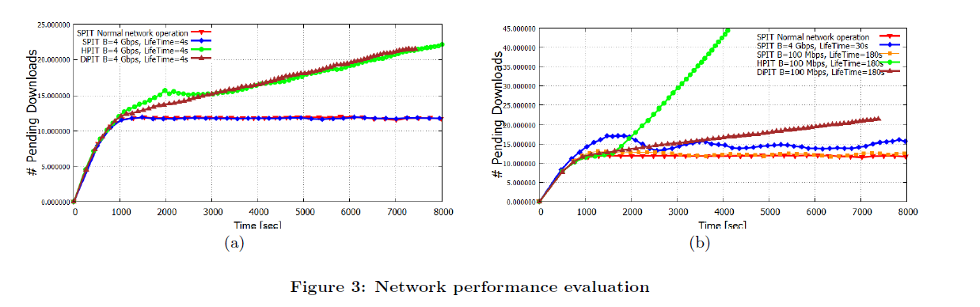
PIT Resilience Analysis – Discussion (2/4)
Notes:
We can conclude that the HashedPIT is the ar-
chitecture most aected by the considered attack, while the
SimplePIT is the architecture most resilient for the reasons
explained above.

Slide 24
PIT Resilience Analysis – Discussion (3/4)
HashedPIT is the architecture most affected by the considered attack
SimplePIT is the architecture most resilient for the reasons explained above.
The DiPIT has an intermediate behavior.

Slide 25
PIT Resilience Analysis – Discussion (4/4)
Other specific attacker behaviors
Combine broad bandwidth and higher LifeTime to increase attack effectiveness
Distribute more zombies around the network to avoid attack source detection
Exploit more bad prefixes in order to make any countermeasures even more complex to deploy.

